Slide 1
Format code in Visual studio 2019
Do Quoc Binh

Slide 2
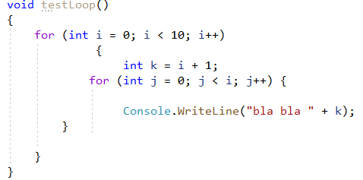
Format the code when it is not looking good like this

Slide 3
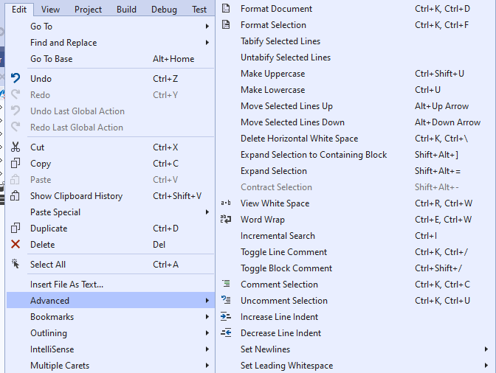
The Edit menu can help you a lot

Slide 4
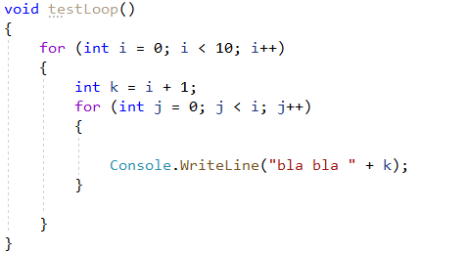
Appling “Format Document”

Slide 5
Customize your C# editor
Code style preferences can be set for all of your C# and Visual Basic projects by opening the Options dialog box from the Tools menu. In the Options dialog box, select Text Editor > [C#] > Code Style > General.

Slide 6
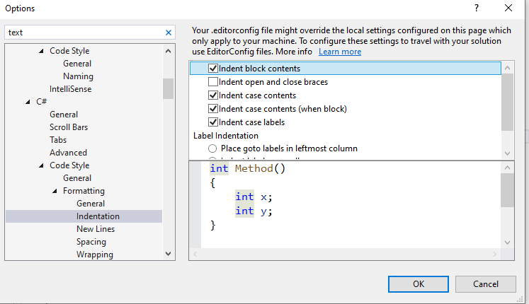
Change settings for the C# editor

Slide 7
Introduction to Code Analysis
The Code Analysis feature of Visual Studio performs static code analysis to help developers identify potential design, globalization, interoperability, performance, security, and a host of other categories of potential problems.

Slide 8

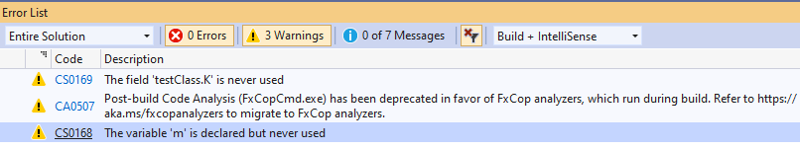
Code Analysis

Slide 9
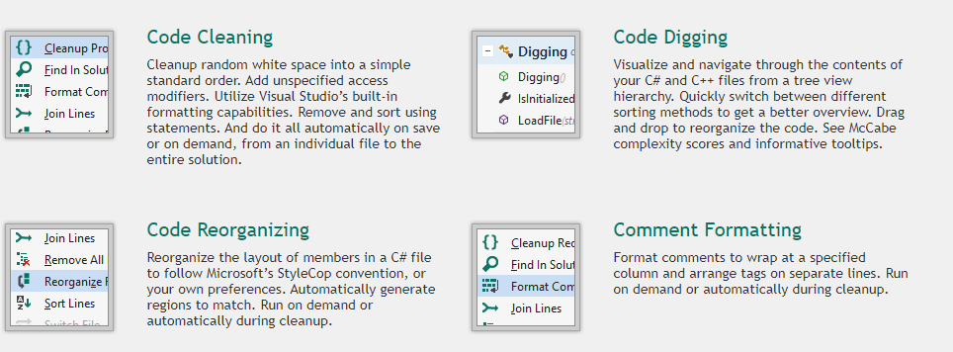
CodeMaid
An open source Visual Studio extension to cleanup and simplify C#, C++, F#, VB, PHP, PowerShell, R, JSON, XAML, XML, ASP, HTML, CSS, LESS, SCSS, JavaScript and TypeScript coding

Slide 10
Naming convention for C#
https://docs.microsoft.com/en-us/dotnet/csharp/programming-guide/inside-a-program/coding-conventions
https://csharpcodingguidelines.com/naming-guidelines/

Slide 11
XML comments

Slide 12
XML comment Walkthrough
https://docs.microsoft.com/en-us/dotnet/csharp/codedoc

Slide 13
Exercise
Create a console program which allows the Admin to create Classes and assign Student to class.
You are free to add properties and classes
Check your classmate’s program and create a report to show how correct and incorrect of the coding convention

